Slide 1
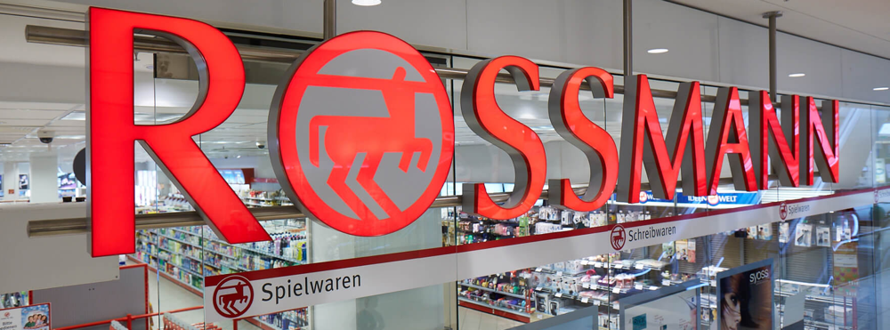
SALES PREDICTION ACROSS MULTIPLE STORES
By:- Ankur Kumar

Slide 2
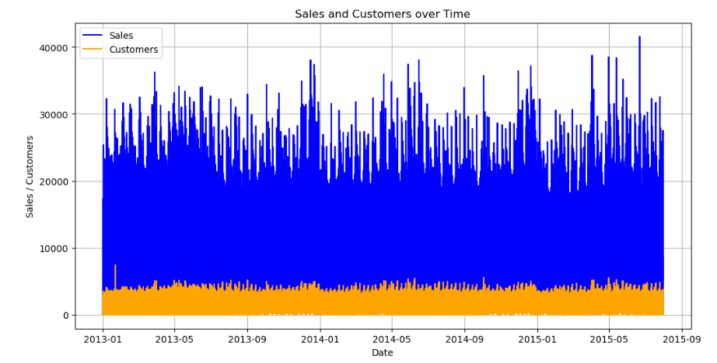
The sales is directly related to customer

Slide 3
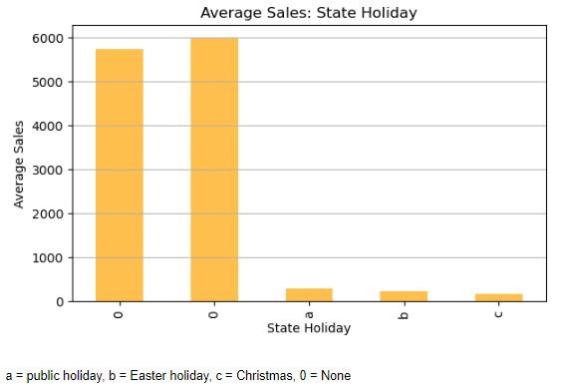
Average Sales: State Holiday

Slide 4
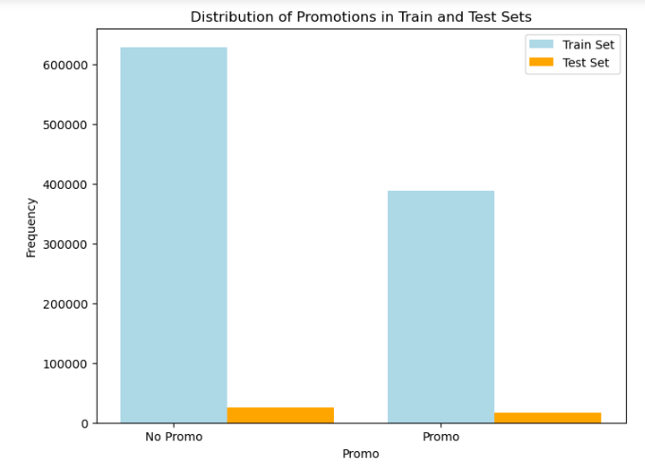
Distribution of Promotions in Train and Test Sets
For train data
The distribution of sales with promotion the frequency has reached almost 400000 but the distribution of sales without promotion the frequency has reached more that 600000
For test data
The distribution of sales with promotion and without promotion has only slit difference between them
It's important to note that the test data only covers a small period compared to the train data But still the difference of sales with promotion and without promotion is huge there might be the other factors behind that

Slide 5
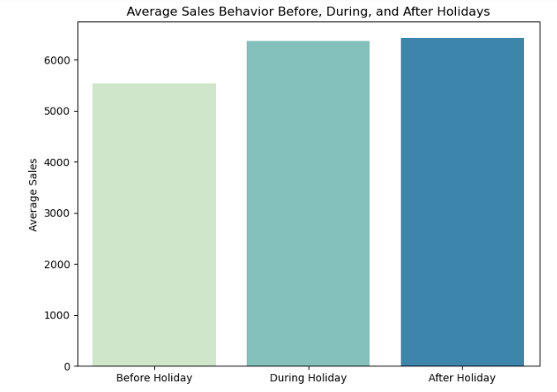
Average Sales Behavior Before, During, and After Holidays
Average Sales Behavior Before, During, and After Holidays:
Based on the analysis, we have collected before the holidays the average sales behavior is around the numbers of 5500. During the holidays the average sales behavior is around the numbers of 6200. After the holidays the average sales behavior is around the numbers of 6250.

Slide 6
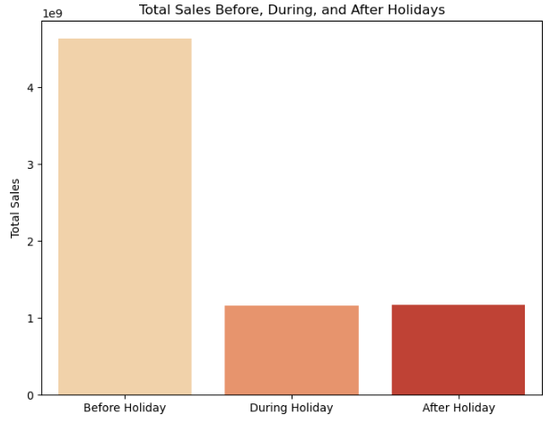
Total Sales Before, During, and After Holidays
Based on the analysis, we have collected before the holidays the average sales behavior is around the numbers of 5500. During the holidays the average sales behavior is around the numbers of 6200. After the holidays the average sales behavior is around the numbers of 6250.
The total sales behavior before, during, and after Holidays:
Based on the analysis, we have collected the highest total sales we have is before the holidays. during the holidays and after the holidays the total sales rename the same.

Slide 7
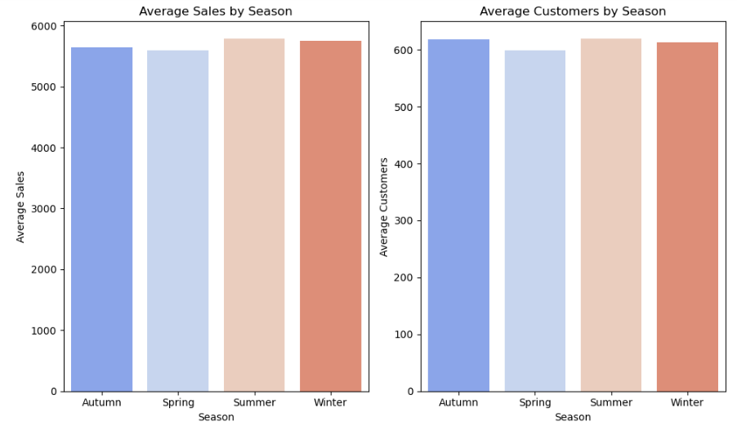
Average Sales & Customers by Season
For "Average Sales by Seasons":
Summer season has the most average sales in all of the four seasons and Spring season has the least average sales in all of four seasons but according to bar polt all the season's average sales are fall between 5000 to 6000
For "Average Customers by Season":
Summer season and Autumn season has the most and same number of average customer more that 600 and Spring season has the least number of average customer in all of season little less than 600
The conclusion is that the Summer season has the higest sales in all seasons and the Spring season has the lowest sales in all seasons

Slide 8
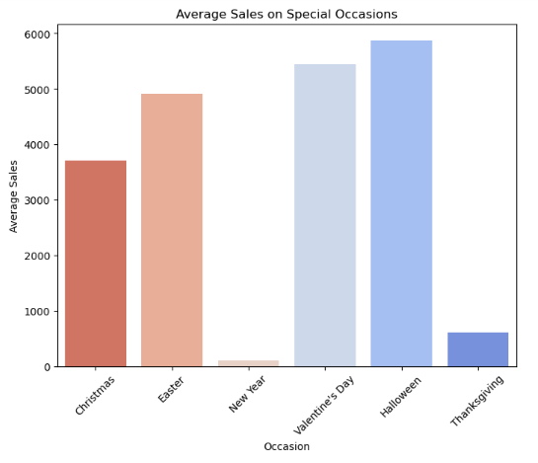
Average Sales on Special Occasions
In this presentation, we delve into the intriguing correlation between Halloween, the beginning of winter, and its impact on pharmaceutical store sales. Halloween drives consumer behavior, leading to increased spending and social gatherings .
As Halloween arrives, it signals the onset of the winter season with colder weather and climatic changes .
This transition has notable health implications, making individuals more susceptible to illnesses like colds, flu, and seasonal affective disorder.
Consequently, pharmaceutical store sales surge, as consumers seek health-related products.
To capitalize on this surge, pharmaceutical stores can employ seasonal marketing strategies while also addressing specific health needs during winter.
In conclusion, recognizing and catering to this seasonal sales phenomenon is key for pharmaceutical stores.

Slide 9
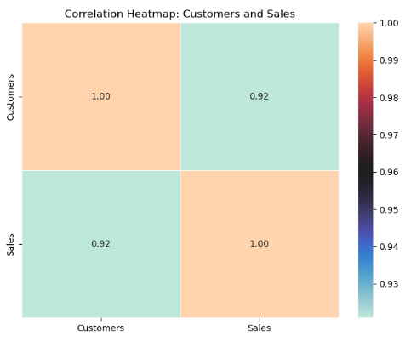
Correlation Heatmap: Customers and Sales
Based on the analysis, This value indicates a strong positive correlation between these two variables. It suggests that there is a significant relationship between the number of customers visiting the stores and the sales generated. In other words, as the number of customers increases, the sales tend to increase as well, and vice versa.
This strong positive correlation is expected since it is common for businesses to experience higher sales when there are more customers. The high correlation coefficient suggests that the number of customers is a good indicator of sales performance, and it can be a useful feature for predicting future sales in the dataset.

Slide 10
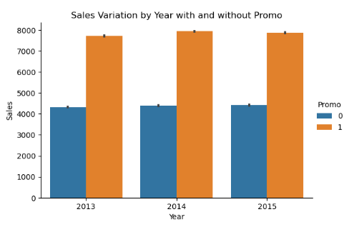
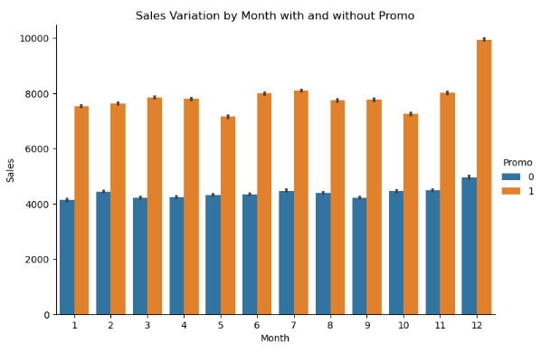
Sales Variation with and without Promo
Sales Variation by Year with and without Promo
Sales Variation by Month with and without Promo

Slide 11
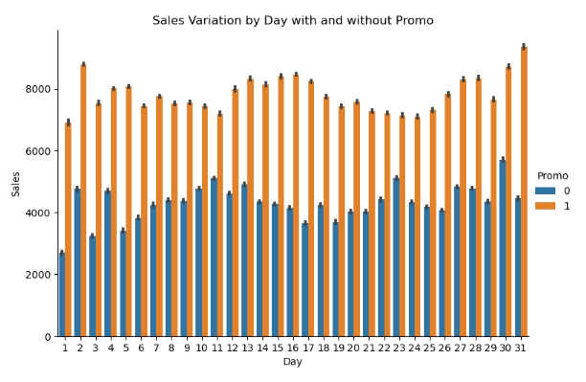
Sales Variation by Day with and without Promo

Slide 12
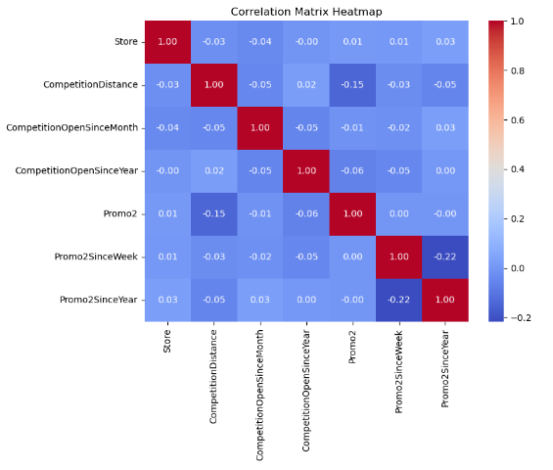
Correlation Matrix Heatmap

Slide 13
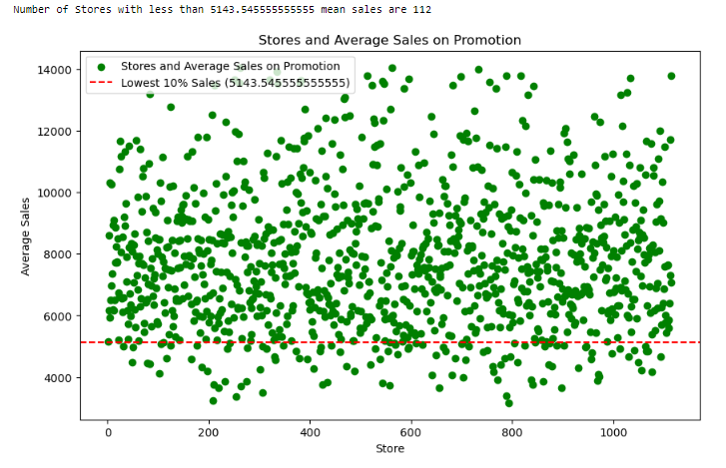
Stores and Average Sales on Promotion

Slide 14
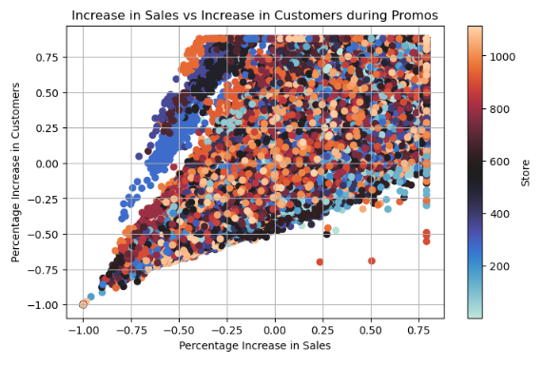
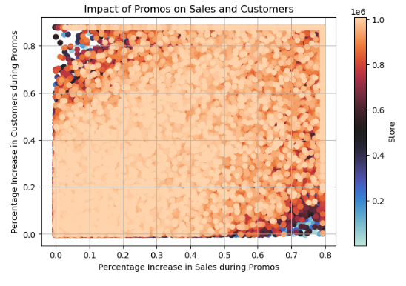
Based on the analysis, it appears that promos can be deployed in more effective ways, and there are specific stores where promos show a significant impact on both sales and customer numbers. The analysis suggests that there are certain stores where promos lead to a considerable increase in both sales and customer visits. These stores have shown the highest percentage increase in sales and customers during promotional periods compared to the average sales and customers across all stores. To make the promos more effective, the company should consider focusing on these specific stores where promos have a strong positive impact. By targeting these stores with well-planned and strategic promotional activities, the company can further enhance sales and customer engagement during promo periods. In summary, promos should be deployed in a more targeted and strategic manner, with a particular focus on the stores that have shown the highest impact in terms of increased sales and customers during promotional periods. This approach can maximize the effectiveness of promos and lead to better overall performance for the company.
Increase in Sales vs Increase in Customers during Promos
Impact of Promos on Sales and Customers

Slide 15
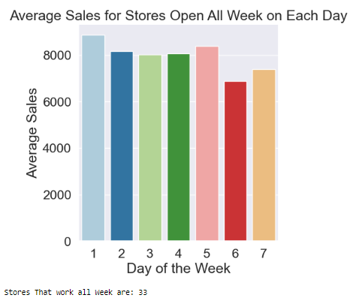
Average Sales for Stores Open All Week on Each Day
Store that work all week are 33
Based on the analysis, the stores operating on all weekdays and their weekend sales performance. Understanding the impact of weekday operations on weekend sales provides valuable insights for store management to refine strategies, enhance customer engagement, and optimize overall business performance. By leveraging these findings, retailers can make informed decisions to foster sustained growth and customer satisfaction

Slide 16
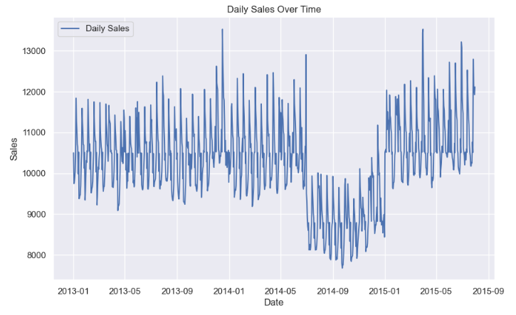
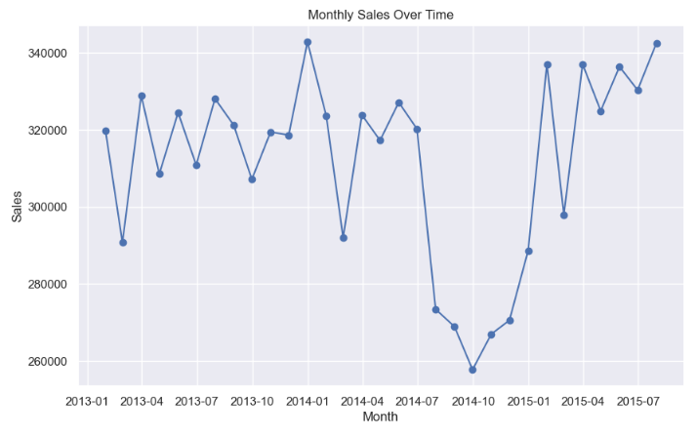
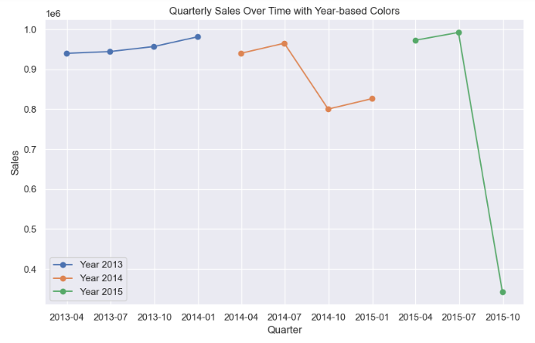
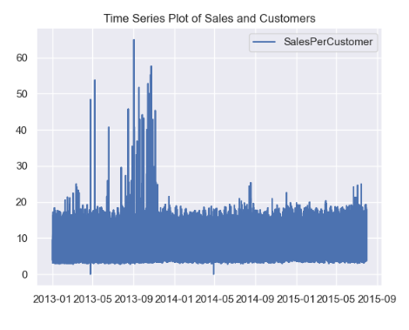
Trend Analysis

Slide 17
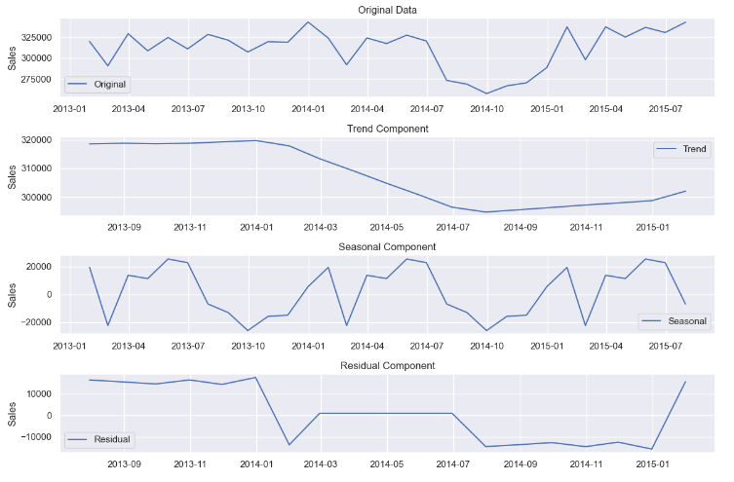
Residual Component

Slide 18
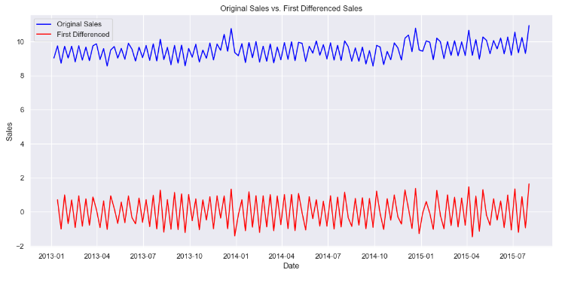
First Differenced Sales represents the sales data after applying a differencing operation, specifically taking the difference between each data point and the previous one. The differencing process have reduced the overall variability or patterns in the data, making it appear more stable or stationary.

Slide 19
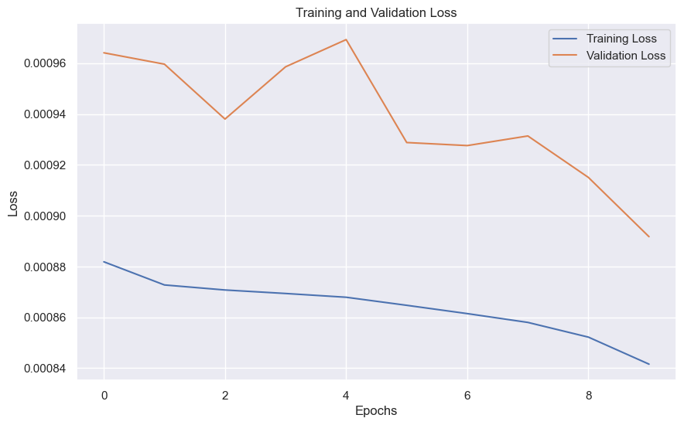
The training loss of 0.00088 and the validation loss of 0.00096, both sustained over 8 epochs, indicate a model that has achieved a high level of accuracy and generalization.
The training loss reflects how well the model is fitting the training data, and the validation loss gauges the model's performance on unseen data.

Slide 20
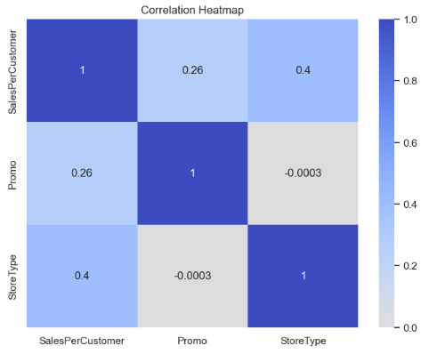

Slide 21
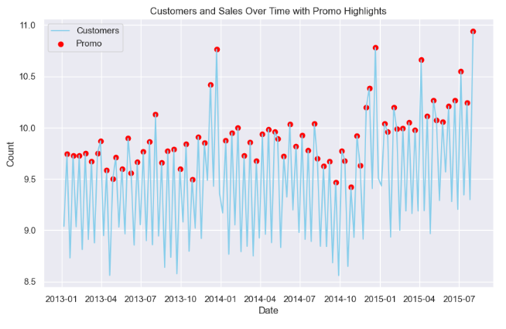
Customers and Sales Over Time with Promo Highlights

Slide 22
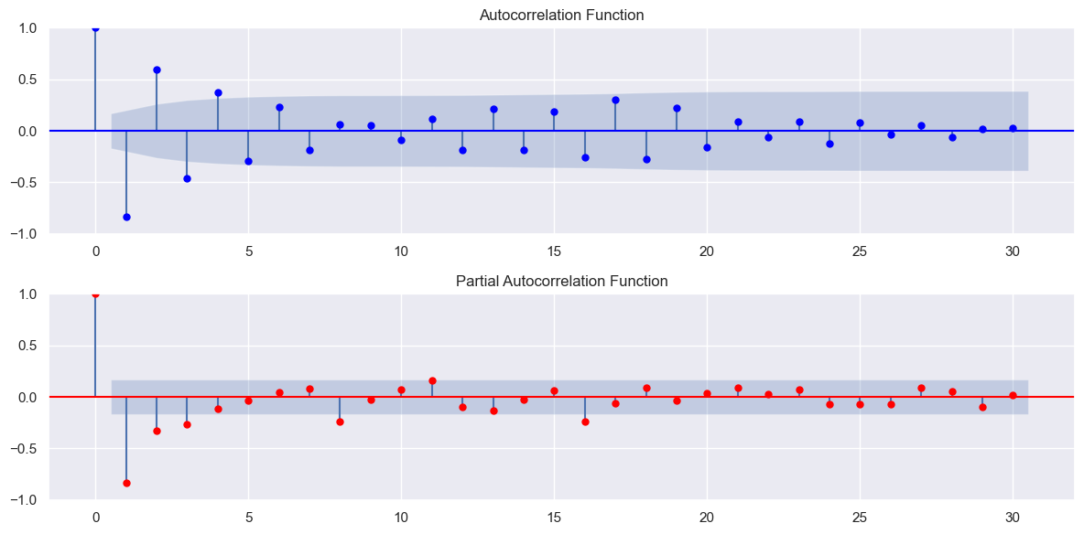
A fluctuating ACF pattern with both falling and rising values typically signifies seasonality within the data. It suggests regular, repeating cycles at specific time intervals.
On the other hand, when PACF values are notably lower than ACF values, it indicates that the direct correlation between the current observation and its past lags is relatively weak compared to the influence of other lags or variables.

Slide 23
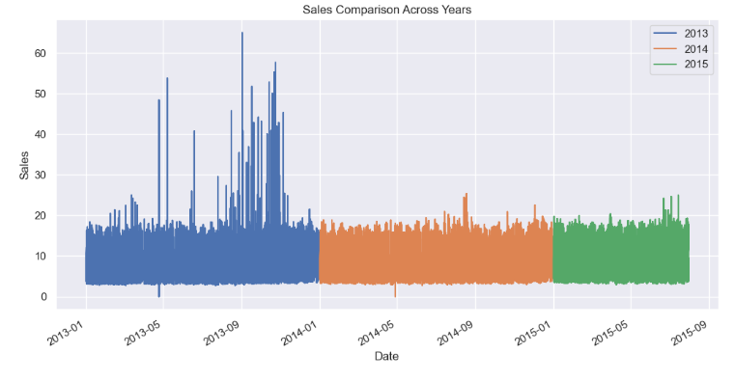
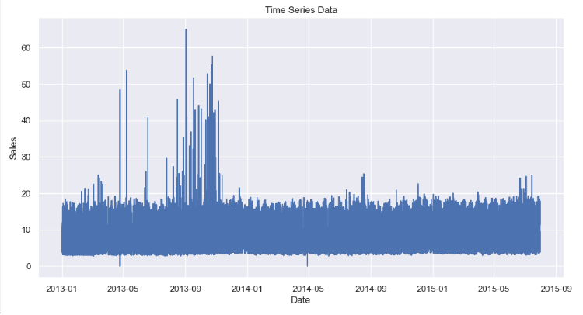

Slide 24
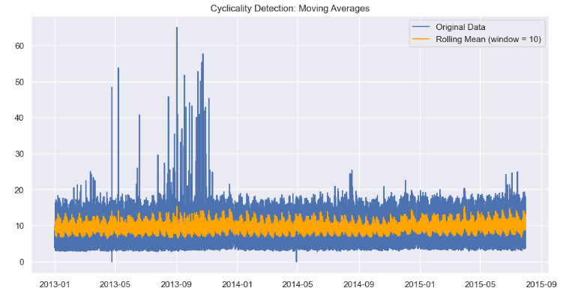
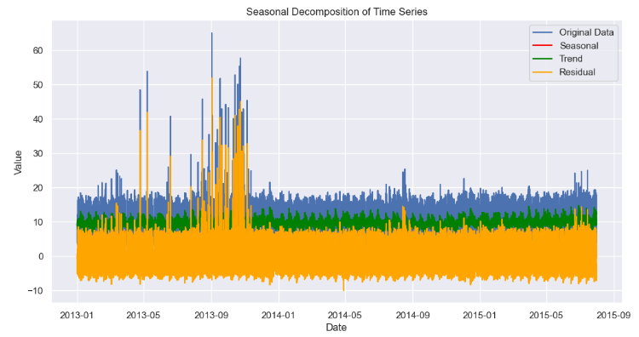

Slide 25
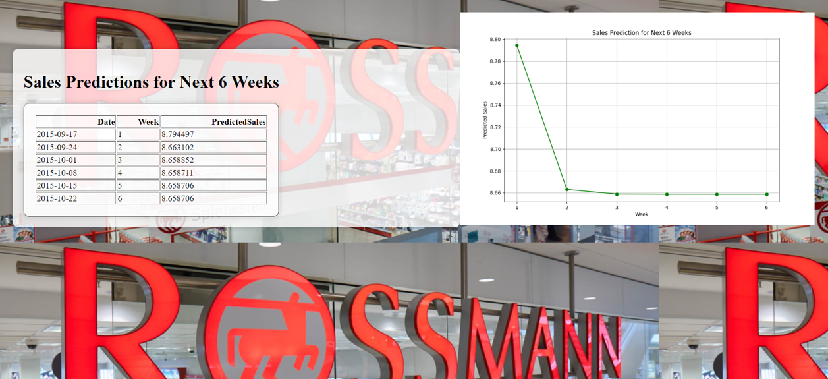
Sales Prediction for next 6 Weeks

Slide 26
Thank You
By:- Ankur Kumar

